Slide 1
Optical Components of Sensors (Continue)
Presented by:
MOHAMMED HASAN MOHAMMED ALGAMALI
ID No.: 6118000082

Slide 2
Outlines:
Concentrators
Coatings for Thermal Absorption
Nano-optics

Slide 3
1. Concentrators
There is an important issue of increasing density of the photon flux impinging on the sensor’s surface. when only the energy factors are importance, and a focusing or imaging is not required, special optical devices can be used for that which are the concentrators.

Slide 4
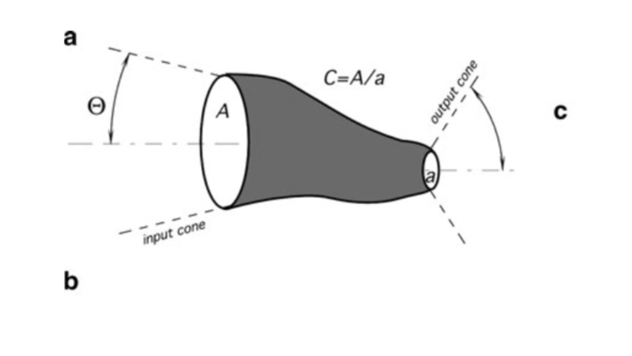
Concentrators Futures
Properties of the waveguides((like lenses and curved mirrors).
The concentrator collects light from a larger area and directs it to a smaller area.

Slide 5
Concentrator

Slide 6
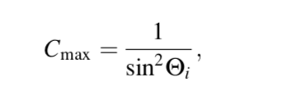
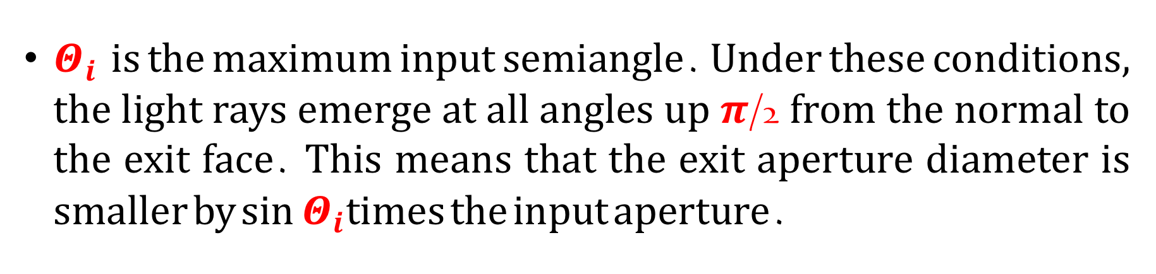
Concentrators Futures
For concentration ratio C there is a theoretical maximum:
$Θ_{i}$ is the maximum input semiangle. Under these conditions, the light rays emerge at all angles up $π$/2 from the normal to the exit face. This means that the exit aperture diameter is smaller by $\sin{Θ_{i}}$times the input aperture.

Slide 7
2. Coatings for Thermal Absorption
This kind of sensors rely on absorption of the electromagnetic waves in the mid- and far-infrared spectral ranges.

Slide 8
Coatings for Thermal Absorption
There is several methods to give a surface the emissive (absorptive) properties:
Some of them are deposition of thin metal films (like nichrome) having good emissivity.
Galvanic deposition of porous platinum black.
Evaporation of metal in atmosphere of low-pressure nitrogen.

Slide 9
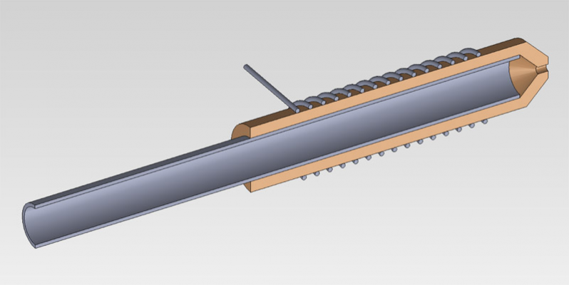
Coatings for Thermal Absorption
Nichrome Wire Temperature Sensing

Slide 10
3. nano-Optics
Nano-optics: is the study of the behavior of light on the nanometer scale, and of the interaction of nanometer-scale objects with light.

Slide 11
nano-Optics
Nano-optics deals with the interaction of light with particles.
Nano-optics is a class of optical devices based on finely patterned materials with critical dimensions several times smaller than the wavelength of light at which they are applied.
By combining material and structural properties, nano-optics allow optical devices offer high performance. Because nano-optic devices are produced using semiconductor.

Slide 12
Example nano-Optics
Solar cells: Solar Cell work best when the light is absorbed very close to the surface, because electrons near the surface have a better chance of being collected, and because the device can be made thinner.

Slide 13
Example nano-Optics
Digital cameras: can be enhanced because more ‘pixels’ can be placed on a sensor than with existing technology. In addition, sensors can be fabricated on the nano-scale so that they will be of higher quality.

Slide 14
Thank You

